Slide 1


MINI PROJECT
PRESENTED BY- MONISHKA SINGH

Slide 2
Introduction
Being a student in this world of applications is not an easy job, especially when you want to be a multi-tasker.
So this project is an attempt to save the time of the students by helping them to find all the applications at one place, which they readily use.

Slide 3
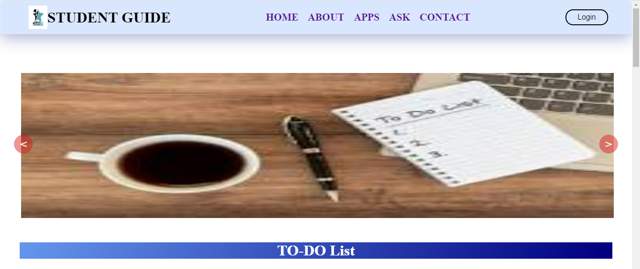
HOME PAGE

Slide 4
The APPLICATIONS AVAILABLE
CALCULATOR
E-CONTENT
GAMES
RESUME BUILDER
SCREEN SAVER
ASK YOUR MENTOR
TO-DO LIST

Slide 5
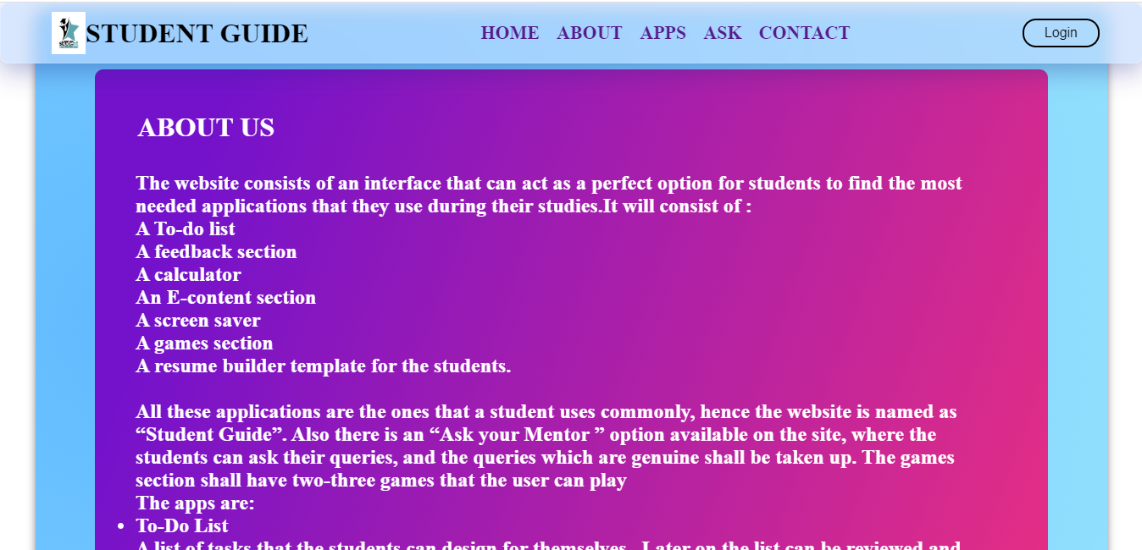
ABOUT SECTION
This section contains information that might answer the question, “What is in the website for me”
It gives an overview of the utility of the website.

Slide 6

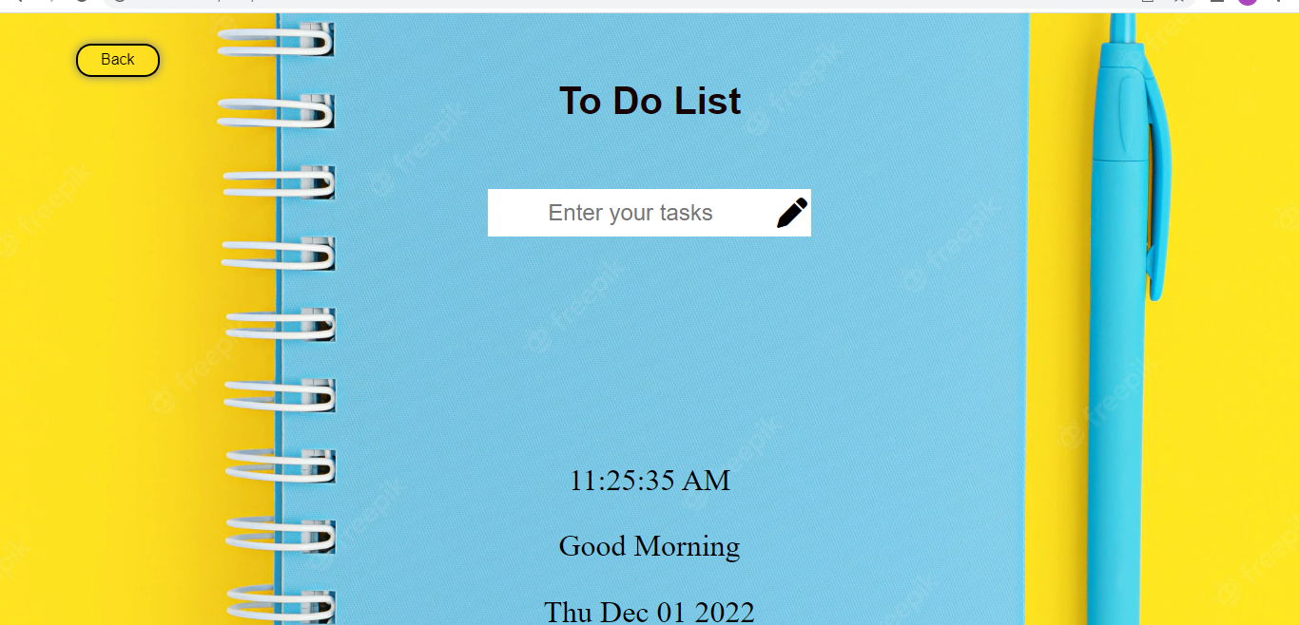
TO-DO LIST
A to-do list is a daily task keeper with local storage.
The students can write their tasks and can delete them or mark them as complete as and when required.

Slide 7
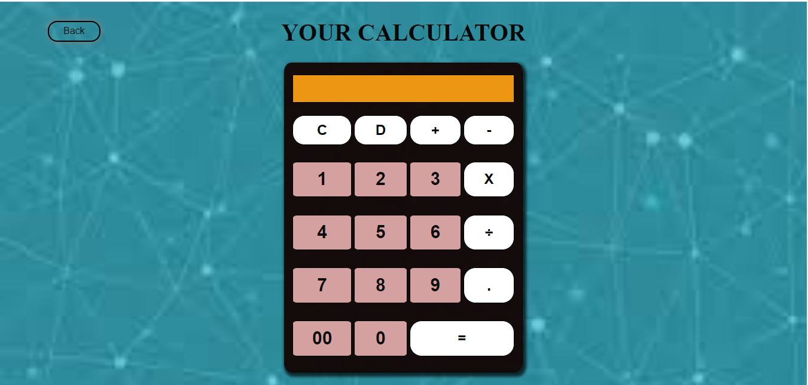
CALCULATOR
To compute the results of various arithmetic operations this application can be used.
The operations like addition, subtraction, multiplication and division can be done using this application.

Slide 8
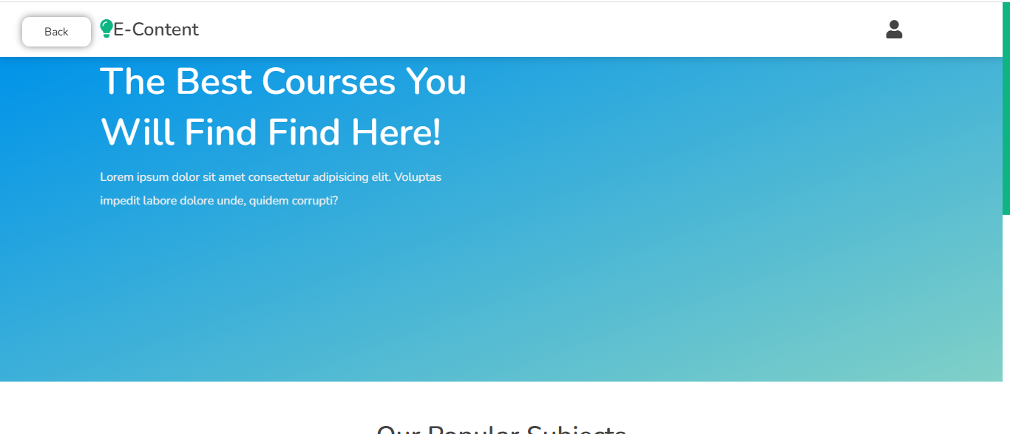
E-CONTENT
This section consists of various courses that the students can choose from like science, web development, engineering, etc
Also the students will be re-directed to the course website after choosing a particular course.
The objective of this application is to help the students find all the content for their studies at one place.

Slide 9
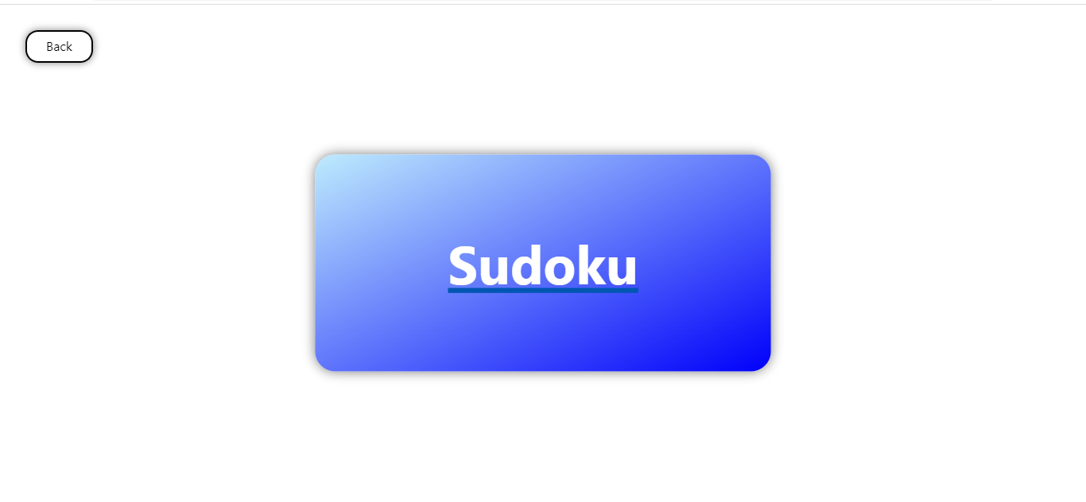
GAMES
This section contains games that the students can play during their free-time
The section contains a SODUKU-SOLVER

Slide 10
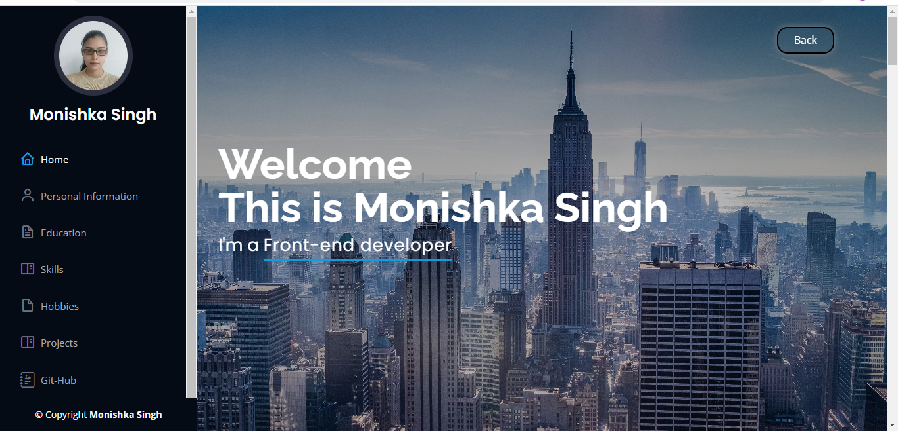
RESUME-BUILDER
This application contains a resume-builder template which the students can use to make a resume of their own.
The application also has a pre-built resume template.

Slide 11
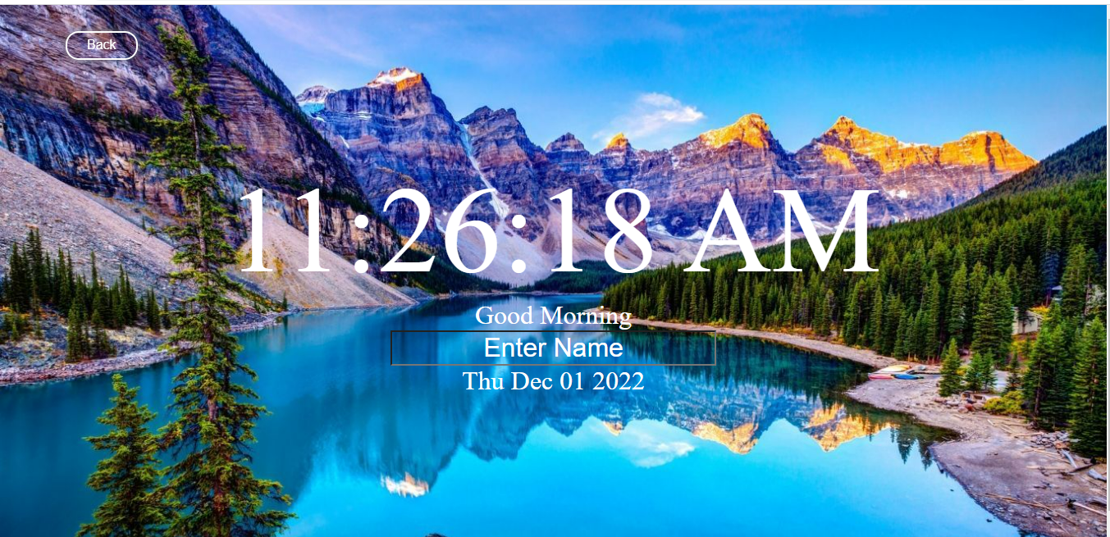
SCREEN-SAVER
This application consists of a screen-saver that also has a clock and a personalized message can be added to it.

Slide 12
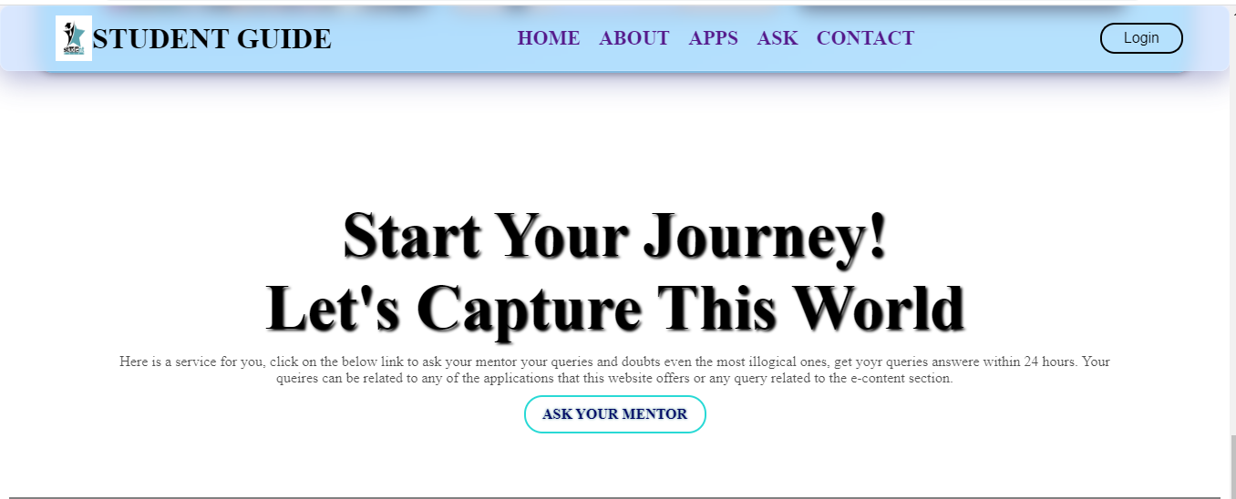
ASK YOUR MENTOR
This is basically a button that can be used to ask queries to the mentor.
The queries shall be answered within 24 hours from being raised.

Slide 13
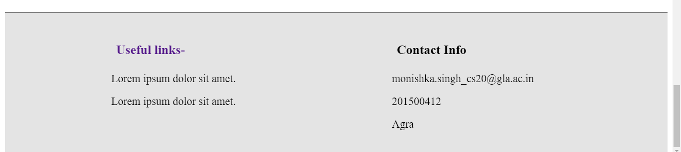
FOOTER SECTION
This consists of the details of the developer and some useful links that can redirect the user.

Slide 14
CONCLUSION AND SCOPE
The website consists of all the necessary tools that a student might require while studying.
This was an attempt to help the students find the right tools at one place.

Slide 15
Thank you

